Slide 1
2023 White House (WH) Visitor Logs
Andrew Pfeifer
DSC 640-T303
Professor Schnieder

Slide 2
Introduction
Throughout the year the White House has many visitors.
Due to the number of visitors, we should ensure that security is first in all our minds.
Not knowing who the visitors are here to see poses a security risk to everyone in the white house as we’re unable to track the locations they’re visiting.
The White House visitor logs need to be PROPERLY COMPLETED to prevent security risks to the white house and its guests.

Slide 3
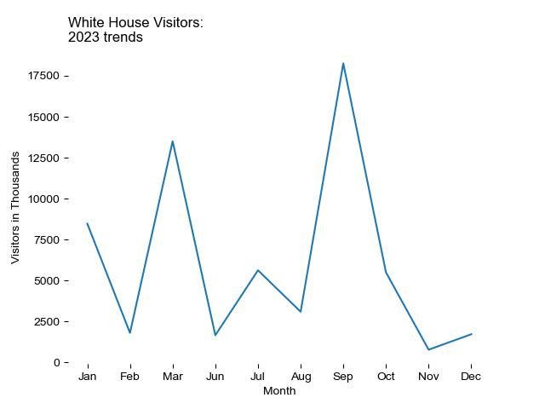
2023 Monthly WH Visitors
Monthly visitors to the White House tend to peak between February to March and from August to October.
These increases of visitors could be due to a general vacation time people take in the summer or can be related to school visits.

Slide 4
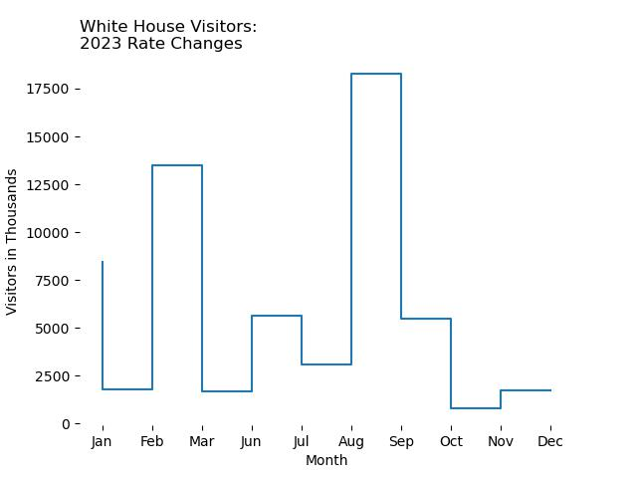
2023 Monthly WH Visitor Rate Change.
To better see the change in the rate of visitors, a step chart is used.
We see that the visitors have sharp increased in February as well as in August.
At the end of the year the rate of White House visitors are low.

Slide 5
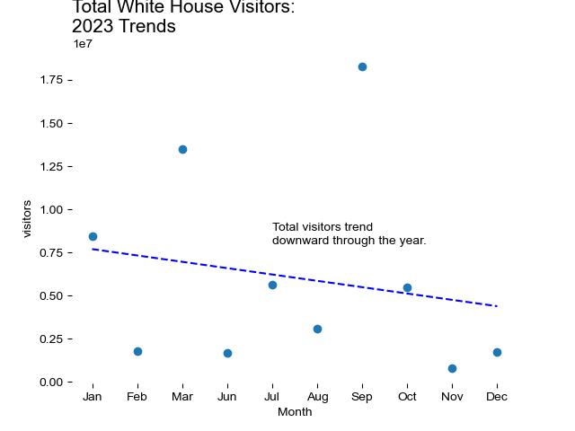
2023 WH Visitor Trend Line.
As shown to the right the line of best fit has a downward trend through out the year for visitors.
March and September are seen as outliers.
With all these visitors, it’s important to know what/ who they’re visiting while in the White House.

Slide 6
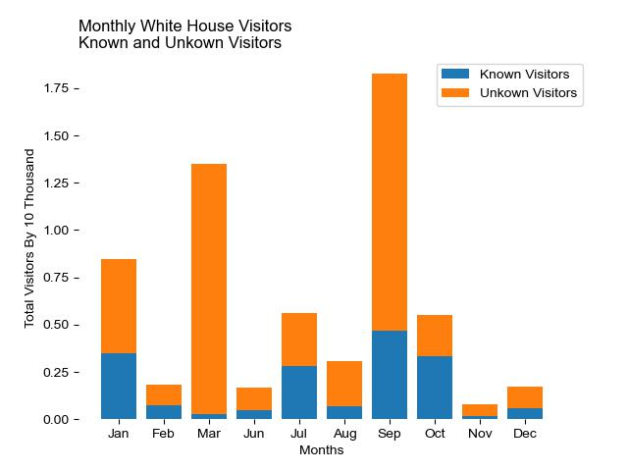
Known Vs Unknown Visitors
In the 2023 year there were more visitors to the White House with an unknown location or person they were visiting per month as compared to known .
Very little tends to be logged for the known location/ person being visited, especially in March and November.
This creates a security risk if we do not know who is being visited as we can’t confirm which locations the visitor will be in.

Slide 7
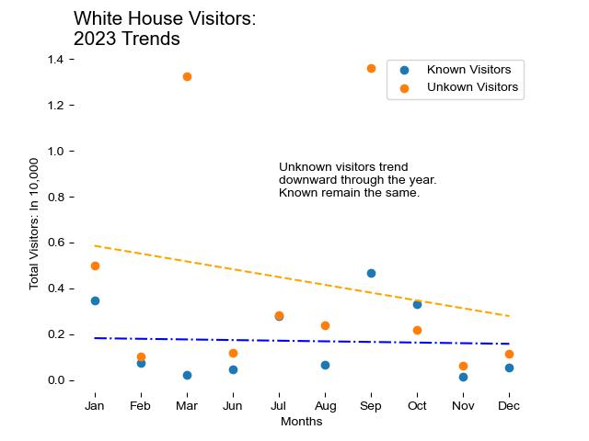
Trend Line For known and Unknown Visitors.
The known visitors tends to remain constant through the year.
The Unknown visitors has a downward trend through out the year.
The impact of the unknown visitors is so significant it impacts the total visitor trend line.

Slide 8
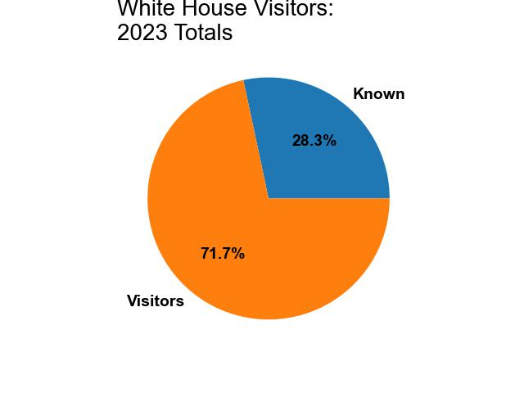
2023 Visitor Totals
Only 28.3% of visitors in 2023 had the location/ person visited notated in the logbook.
Almost 72% of visitors were missing this information from the logs.
This can cause us to lose track of where to focus security in the White House.

Slide 9
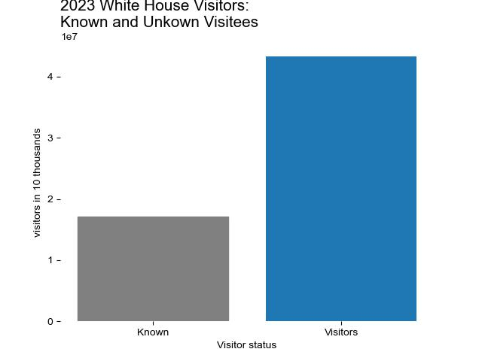
2023 Visitor Totals Continued
The visitors with an unknown location are represented by the blue bar.
This is more than double the visitors with a known location.
The current practice for logging location is unacceptable.

Slide 10
Conclusion
Almost 72% of people visiting the white house had the name or location of the visitee unlogged.
This value is so significant that it impacts the overall trends of white house visitors.
When we have spikes in visitors, the unknown visitees increase faster than the known visitees.
This can cause a security risk to the white house if we do not know where the visitors will be to properly monitor those areas.
The White House visitor logs need to be properly filled in to prevent this security risk.

